Slide 1
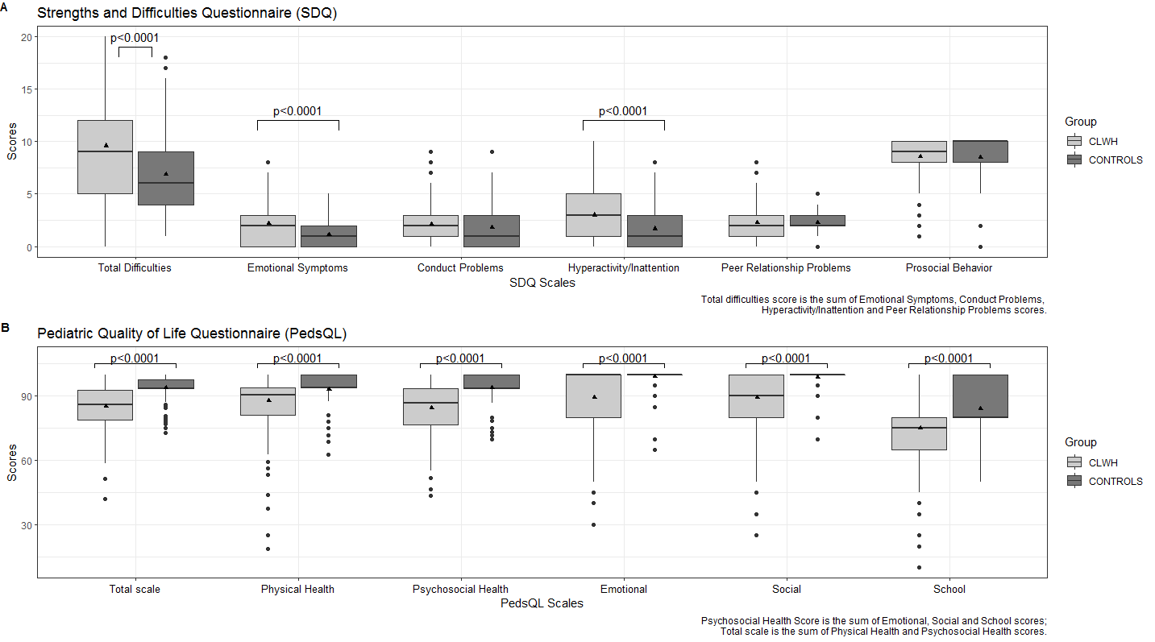
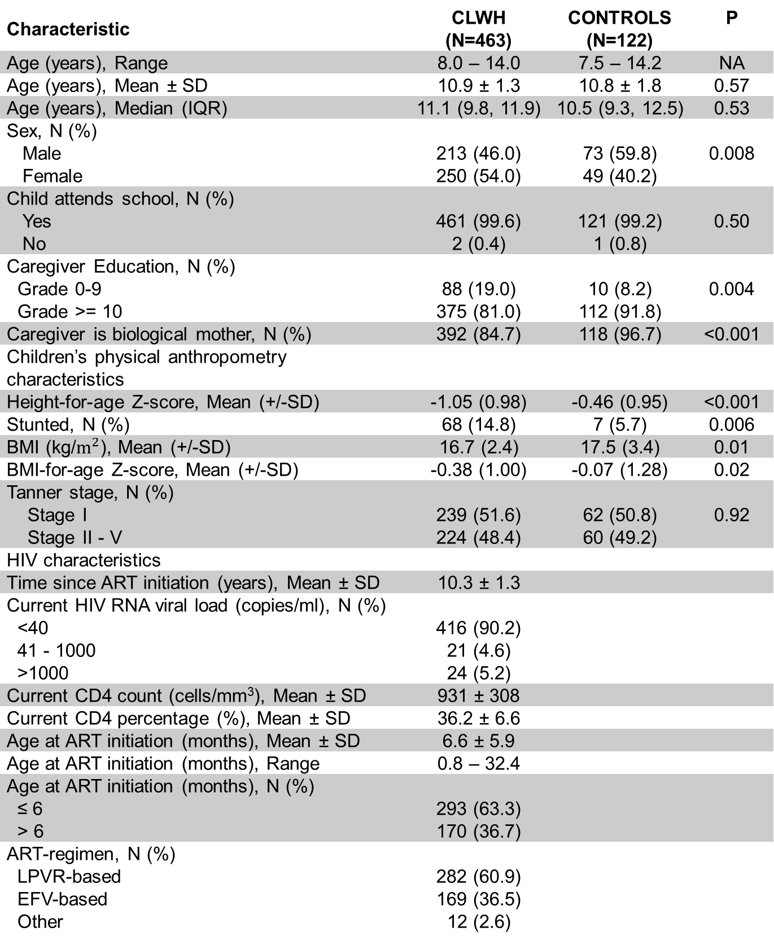
Mental health and quality of life in children living with HIV on antiretroviral therapy
PEB0326
Authors: Stephanie Shiau¹, Henry Evans², Renate Strehlau³, Yanhan Shen⁴, Megan Burke³, Afaaf Liberty⁵, Ashraf Coovadia³, Elaine J. Abrams^{6,7,8}, Michael T. Yin², Avy Violari⁵, Louise Kuhn^{4,7}, Stephen M. Arpadi^{4,7,8}
Affiliations: ¹Department of Biostatistics and Epidemiology, Rutgers School of Public Health, Piscataway, NJ, USA;
²Department of Medicine, Division of Infectious Diseases, Vagelos College of Physicians & Surgeons, Columbia University Irving Medical Center, New York, NY, USA;
³Empilweni Services and Research Unit, Rahima Moosa Mother and Child Hospital, Department of Paediatrics and Child Health, Faculty of Health Sciences, University of the Witwatersrand, Johannesburg, South Africa
⁴G.H. Sergievsky Center, Vagelos College of Physicians & Surgeons, Columbia University Irving Medical Center, New York, NY, USA;
⁵Perinatal HIV Research Unit, Chris Hani Baragwanath Hospital, University of the Witwatersrand, Johannesburg, South Africa; ⁶ICAP at Columbia University, Mailman School of Public Health, Columbia University Irving Medical Center, New York, NY;
⁷Department of Epidemiology, Mailman School of Public Health, Columbia University Irving Medical Center, New York, NY, USA; ⁸Department of Pediatrics, Vagelos College of Physicians and Surgeons, Columbia University Irving Medical Center, New York, NY, USA
Contact:
Stephanie Shiau, PhD, MPH
Rutgers School of Public Health
Department of Biostatistics and Epidemiology
stephanie.shiau@rutgers.edu
BACKGROUND
METHODS
RESULTS
SUMMARY
In addition to multiple infectious diseases, children living with perinatally-acquired HIV (CLWH) are at increased risk for a number of other morbidities that affect their quality of life and mental health, including developmental delays, motor and cognitive impairment, and behavioral problems.
CLWH are also more likely to experience illness or death of a parent, stigma, and discrimination that are harmful to emotional and social well-being during childhood.
Use of combination antiretroviral therapy (ART) has resulted in substantial reductions in mortality and prevents or mitigates many of the more severe manifestations of perinatally-acquired HIV.
In addition, many but not all studies conducted in both well- and less-resourced settings find better neurodevelopmental outcomes associated with ART.
These studies vary with respect to therapeutic agents, duration of observations, consistency of viral suppression, as well as age, immune status and stage of disease at time of treatment initiation. More recent reports from clinical trials involving children started on ART at early ages with less advanced disease find even greater benefit; however, neurocognitive deficits and behavior problems persist.
Data on the overall impact of HIV infection, HIV-associated conditions, and quality of life – i.e. the physical, psychological, school-related, and social well-being – among CLWH who initiate ART early in life and maintain viral suppression are limited. Prior studies report lower quality of life with significant deficits in physical as well as social, emotional and school functioning.
Few of these studies, however, are able to account for age of ART initiation and degree of viral suppression.
Measurements
Table 1:
463 CLWH and 122 controls without HIV were included in this analysis.
A greater proportion of CLWH were female compared with controls.
Mean age was similar between groups.
Almost all (99.5%) children attended school.
More controls had their mother as their primary caregiver than CLWH.
A greater proportion of caregivers of controls completed lower secondary school (grade 9) compared with CLWH.
At the time of the study visit, all CLWH were on ART initiated at a mean age of 6.6 ± 5.9 months (range 0.8 – 32.4), with 60.9% on a LPV/r-based regimen and 36.5% on an efavirenz-based ART regimen. Twelve children were on other regimens.
Most children (90.2%) were virally suppressed with an HIV RNA less than 40 copies/ml.
The mean CD4+ T-cell count was 931 ± 308 cells/mm3 and CD4+ T-cell percentage was 36.2 ± 6.6%.
About two thirds (63.3%) of CLWH initiated ART ≤6 months of age and 36.7% initiated ART >6 months of age.
Figure 1:
On the SDQ CLWH had a higher mean total difficulties score (9.6 ± 5.3 vs. 6.7 ± 3.9, p<0.0001), emotional symptoms score (2.2 ± 2.1 vs. 1.1 ± 1.3, p<0.0001), and hyperactivity/inattention score (3.0 ± 2.4 vs. 1.6 ± 1.8, p<0.0001) than controls.
On the PedsQL™, CLWH had a lower mean total quality of life score (85 ± 10 vs. 94 ± 5, p<0.0001), physical health summary score (88 ± 11 vs. 93 ± 7, p<0.0001), and psychosocial health summary score (85 ± 11 vs. 94 ± 6, p<0.0001) than controls.
In addition, CLWH had lower mean scores on the emotional functioning (89 ± 15 vs. 99 ± 5, p<0.0001), social functioning (89 ± 13 vs. 99 ± 5, p<0.0001), and school functioning (75 ± 15 vs. 84 ± 12, p<0.0001) scores that comprised the psychosocial health summary score.
Findings were similar when stratified by sex (data not shown)
Table 2:
Study site, caregiver education, and caregiver age were associated with SDQ scores, whereas whether the mother was the primary caregiver, caregiver marital status, and number of children in the family, were not.
Study site, caregiver education, caregiver age, and whether the mother was the primary caregiver were associated with PedsQL™ scores, whereas caregiver marital status and number of children in the family, were not.
In a multivariable analysis adjusted for age, sex, study site, caregiver education, and caregiver age, on the SDQ, CLWH had a higher total difficulties score [1.1 (95% CI: 0.0, 2.3)], and hyperactivity/inattention [0.8 (95% CI: 0.3, 1.3)] sub-scale score compared to controls.
On the PedsQL™, CLWH had lower mean scores on the total quality of life score [-4.6 (95% CI: -6.4, -2.7)] and psychosocial health score [-5.6 (95% CI: -7.6, -3.5)], adjusted for age, sex, study site, caregiver education, caregiver age, and whether the mother was the primary caregiver.
Table 1: Characteristics of CLWH and controls without HIV
CLWH with well-controlled infection who started ART early in life are at increased risk for behavioral and mental health problems and poorer quality of life compared to healthy children from the same community and similar socioeconomic status.
The SDQ has been widely used as a screening tool in African contexts, and specifically in South Africa to identify children at high risk for mental health and behavioral problems. Our findings signal a risk of mental health problems and additional diagnostic assessments may be warranted to aid early intervention.
While it is possible that these findings stem from HIV infection and associated neurocognitive deficits or antiretrovirals used for treatment, social and other contextual factors that were not adequately measured in our study might also contribute to the finding (e.g. death of a parent, frequent parental illness and hospitalizations, membership in a family with a highly stigmatized disease, disclosure status of the CLWH, parental mental health diagnoses, or adverse in utero exposures).
For quality of life, our cohort of CLWH reported lower physical health and psychosocial health on all three subdomains. The higher total difficulty scores and lower prosocial scores found in our cohort are likely to contribute to reduced quality of life and interventions targeting these areas could be beneficial.
Behavioral functioning and quality of life did not appear to be related to age at ART initiation (≤6 months vs. >6 months) or ART regimen (LPV/r-based vs. efavirenz based) among CLWH.
Data were collected on participants’ age, sex, education, anthropometry, and caregiver and household characteristics.
For CLWH, information on their ART regimen was obtained and plasma HIV-RNA levels (lower limit of detection 40 copies/ml) were measured by the Abbott RealTime HIV-1 Assay (Abbott Park, Illinois, USA). CD4 counts and percentage were measured by the TruCount Method (BD Biosciences, Germany).
At the exit visit from CHANGES after ~4 years of follow-up, we assessed behavioral functioning using the Strengths and Difficulties Questionnaire (SDQ), a brief, validated behavioral health screening tool that has been translated and adapted into multiple languages and has been applied in prior studies of children with HIV. Briefly, 25 items related to behavioral and emotional health were rated on a three-point Likert scale. Five sub-scale scores were calculated from these items, including emotional symptoms, conduct problems, hyperactivity/inattention, peer relationship problems, and pro-social behavior. A total difficulties score was calculated based on the first 4 sub-scales. Surveys were completed once by the primary caregiver (parent-rated).
The Pediatric Quality of Life Inventory™ (PedsQL™ version 4.0) was used to measure health-related quality of life. The PedsQL™ Measurement model is a brief, reliable and valid modular approach with 23 items rated on a 5 point Likert scale. PedsQL™ items were scored following standardized methods and three summary scores were created: a total scale score (23 items), a physical health summary score (8 items), and a psychosocial health summary score (15 items). In addition, three sub-scale scores were created for emotional functioning (5 items), social functioning (5 items), and school functioning (5 items). Surveys were completed once by children (self-rated).
Characteristic | CLWH (N=463) | CONTROLS (N=122) | P
Age (years), Range | 8.0 – 14.0 | 7.5 – 14.2 | NA
Age (years), Mean ± SD | 10.9 ± 1.3 | 10.8 ± 1.8 | 0.57
Age (years), Median (IQR) | 11.1 (9.8, 11.9) | 10.5 (9.3, 12.5) | 0.53
Sex, N (%) Male Female | 213 (46.0) 250 (54.0) | 73 (59.8) 49 (40.2) | 0.008
Child attends school, N (%) Yes No | 461 (99.6) 2 (0.4) | 121 (99.2) 1 (0.8) | 0.50
Caregiver Education, N (%) Grade 0-9 Grade >= 10 | 88 (19.0) 375 (81.0) | 10 (8.2) 112 (91.8) | 0.004
Caregiver is biological mother, N (%) | 392 (84.7) | 118 (96.7) | <0.001
Children’s physical anthropometry characteristics
Height-for-age Z-score, Mean (+/-SD) | -1.05 (0.98) | -0.46 (0.95) | <0.001
Stunted, N (%) | 68 (14.8) | 7 (5.7) | 0.006
BMI (kg/$m^{2}$), Mean (+/-SD) | 16.7 (2.4) | 17.5 (3.4) | 0.01
BMI-for-age Z-score, Mean (+/-SD) | -0.38 (1.00) | -0.07 (1.28) | 0.02
Tanner stage, N (%) Stage I Stage II - V | 239 (51.6) 224 (48.4) | 62 (50.8) 60 (49.2) | 0.92
HIV characteristics
Time since ART initiation (years), Mean ± SD | 10.3 ± 1.3
Current HIV RNA viral load (copies/ml), N (%) <40 41 - 1000 >1000 | 416 (90.2) 21 (4.6) 24 (5.2)
Current CD4 count (cells/mm³), Mean ± SD | 931 ± 308
Current CD4 percentage (%), Mean ± SD | 36.2 ± 6.6
Age at ART initiation (months), Mean ± SD | 6.6 ± 5.9
Age at ART initiation (months), Range | 0.8 – 32.4
Age at ART initiation (months), N (%) ≤ 6 > 6 | 293 (63.3) 170 (36.7)
ART-regimen, N (%) LPVR-based EFV-based Other | 282 (60.9) 169 (36.5) 12 (2.6)
CONCLUSIONS
Additional Analyses:
In CLWH, we evaluated the association between age at ART initiation (≤6 months, >6 months) and the SDQ and PedsQL™ scores, adjusted for sex, age, and site. Scores on the SDQ and PedsQL™ did not differ between CLWH starting ART ≤6 months and CLWH starting >6 months.
In an analysis of CLWH limited to the ESRU site, we evaluated the association between ART regimen and the SDQ scales scores and PedsQL™. No significant differences were observed between those on LPV/r and those on efavirenz.
In summary, CLWH demonstrate persistent difficulties in behavioral and emotional functioning and quality of life despite excellent virologic control with effective ART regimens.
While the causes of these deficits are not fully understood, the evidence suggests that the ART regimens these children have received from a reasonably early age have not been sufficient to ameliorate these negative behavioral impacts.
As recommendations about optimal regimens change and ART is started at even earlier ages, it will be important to consider whether improvements in these behavioral and social outcomes can be achieved.
Our findings suggest that behavioral and social interventions may be needed in concert with ART to optimize mental health and quality of life for this vulnerable population throughout the life course.
OBJECTIVE
The aim of this study was to assess behavioral functioning and quality of life of South African school-aged CLWH who initiated ART early in life (mean of 6 months of age) and are clinically stable on ART, and compare these outcomes to a group of children without HIV.
In addition, we compared these outcomes among CLWH by age at ART initiation (≤6 months vs >6 months) and by ART regimen [efavirenz-based vs. ritonavir-boosted lopinavir-based (LPV/r)].
Statistical Analysis
Comparisons of demographics between groups were conducted using Pearson’s chi-squared test (or Fisher’s exact test), Student’s t-test, or Wilcoxon signed-rank sum test, as appropriate.
Multivariable linear regression models were used to assess the association between HIV status and all individual scales and summary scales of SDQ and PedsQL™ questionnaires. We assessed if the following covariates were associated with scores on the SDQ and PedsQL™: age, sex, study site, primary caregiver, caregiver education, caregiver marital status, caregiver age, and number of children in the family. Variables with p-values <0.05 in univariate analysis were included in the multivariable model with HIV status.
Among CLWH only, we assessed the association between age at ART initiation and the SDQ and PedsQL™ scales, adjusted for age, sex and study site. We adjusted for study site since CLWH at PHRU had participated in an early treatment study that led to earlier age at ART initiation.
Finally, we assessed the association between ART regimen (LPV/r vs. efavirenz) and the SDQ scales scores and PedsQL™ among CLWH at ESRU. It was only at this site, that appreciable numbers of children were on an efavirenz-containing regimen. At PHRU, >90% of children were on LPV/r-containing regimens.
All p-values are 2-tailed and p-values <0.05 were considered statistically significant. All statistical calculations were performed using SAS version 9.4 (Cary, North Carolina, USA).
Figure 1: Box plots of scores from the Strengths and Difficulties Questionnaire (SDQ) and Pediatric Quality of Life Inventory (PedsQL™) for CLWH (N=463) and control children (N=122)
Table 2: Adjusted mean difference and 95% confidence interval (CI) from multivariable models of Strengths and Difficulties Questionnaire (SDQ) and Pediatric Quality of Life Inventory (PedsQL™) scores for CLWH (N=463) compared to control children (N=122)
METHODS
Study Population
Scale | Unadjusted mean difference and 95% CI | Adjusted* mean difference and 95% CI
SDQ
Total difficulties score | 2.7 (1.6, 3.7) | 1.1 (0, 2.3)
Emotional symptoms | 1.1 (0.7, 1.5) | -0.1 (-0.3, 0.3)
Conduct problems | 0.3 (-0.1, 0.7) | 0.3 (-0.1, 0.8)
Hyperactivity/Inattention | 1.3 (0.9, 1.8) | 0.8 (0.3, 1.3)
Peer relationship problems | -0.1 (-0.4, 0.2) | 0.1 (-0.2, 0.4)
Strength: Pro-social behavior | 0.1 (-0.3, 0.4) | -0.1 (-0.5, 0.3)
PedsQL™
Total scale score | -8.5 (-10.2, -6.7) | -4.6 (-6.4, -2.7)
Physical health summary score | -5.5 (-7.6, -3.4) | -1.3 (-3.6, 0.9)
Psychosocial health summary score | -9.4 (-11.4, -7.5) | -5.6 (-7.6, -3.5)
Emotional functioning | -9.9 (-12.6, -7.2) | -0.7 (-3.1, 1.7)
Social functioning | -9.3 (-11.6, -6.9) | -6.9 (-9.5, -4.4)
School functioning | -9.1 (-12.0, -6.2) | -9.3 (-12.5, -6.1)
ACKNOWLEDGMENTS
The Childhood HAART Alterations in Normal Growth, Genes, and aGing Evaluation Study (CHANGES) is a longitudinal cohort study of CLWH and controls without HIV conducted at two research sites in Johannesburg, South Africa: the Empilweni Services and Research Unit (ESRU) at Rahima Moosa Mother and Child Hospital and the Perinatal HIV Research Unit (PHRU) at Chris Hani Baragwanath Hospital.
A total of 553 CLWH were recruited from earlier trials and achieved early virologic suppression with commonly prescribed ART.
Control participants were recruited from among eligible siblings or household members of CLWH in the study as well as from those attending the study site for routine outpatient health services. Controls were frequency matched in age bands to the CLWH but no matching by sex was attempted. Controls were interviewed at the same time as the cases.
This analysis uses data collected from the exit visit of CHANGES.
Funded by the National Institutes of Health, Eunice Kennedy Shriver National Institute of Child Health and Human Development (HD 073977, HD 073952)
*SDQ adjusted for age, sex, study site, and caregiver education and caregiver age
*PedsQL adjusted for age, sex, study site, and caregiver education, caregiver age and primary caregiver
PRESENTED AT THE 23RD INTERNATIONAL AIDS CONFERENCE (AIDS 2020) | 6-10 JULY 2020

